Slide 1
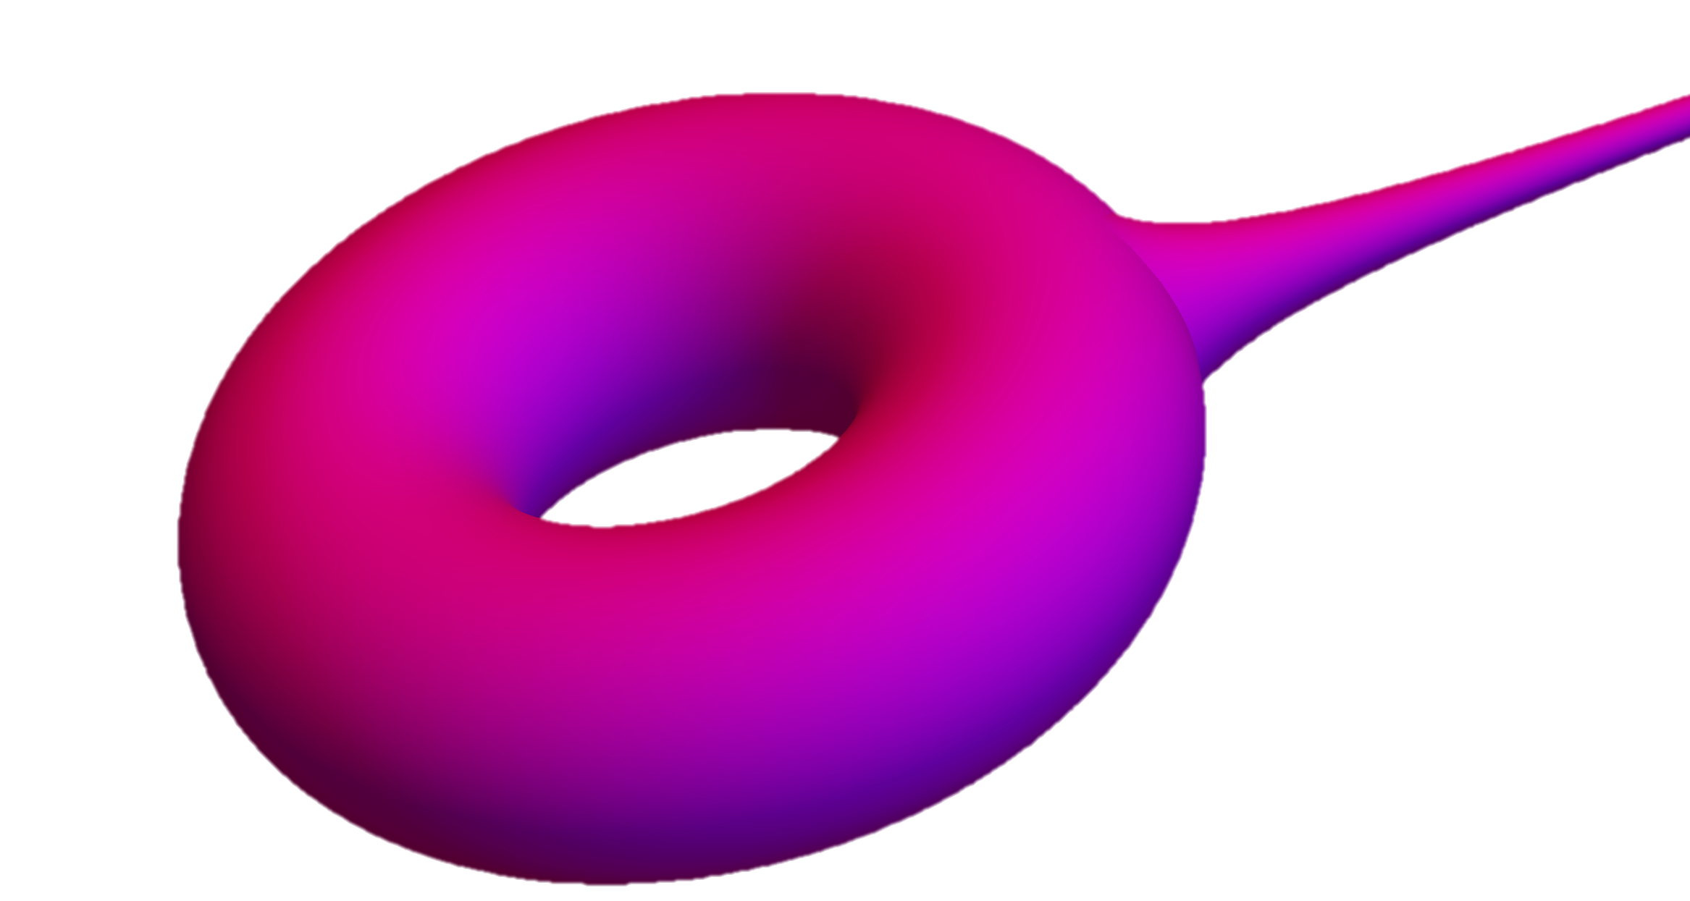
Living on a Hyperbolic Donut
By Ajeet Gary
University of Maryland
Experimental Geometry Lab

Slide 2
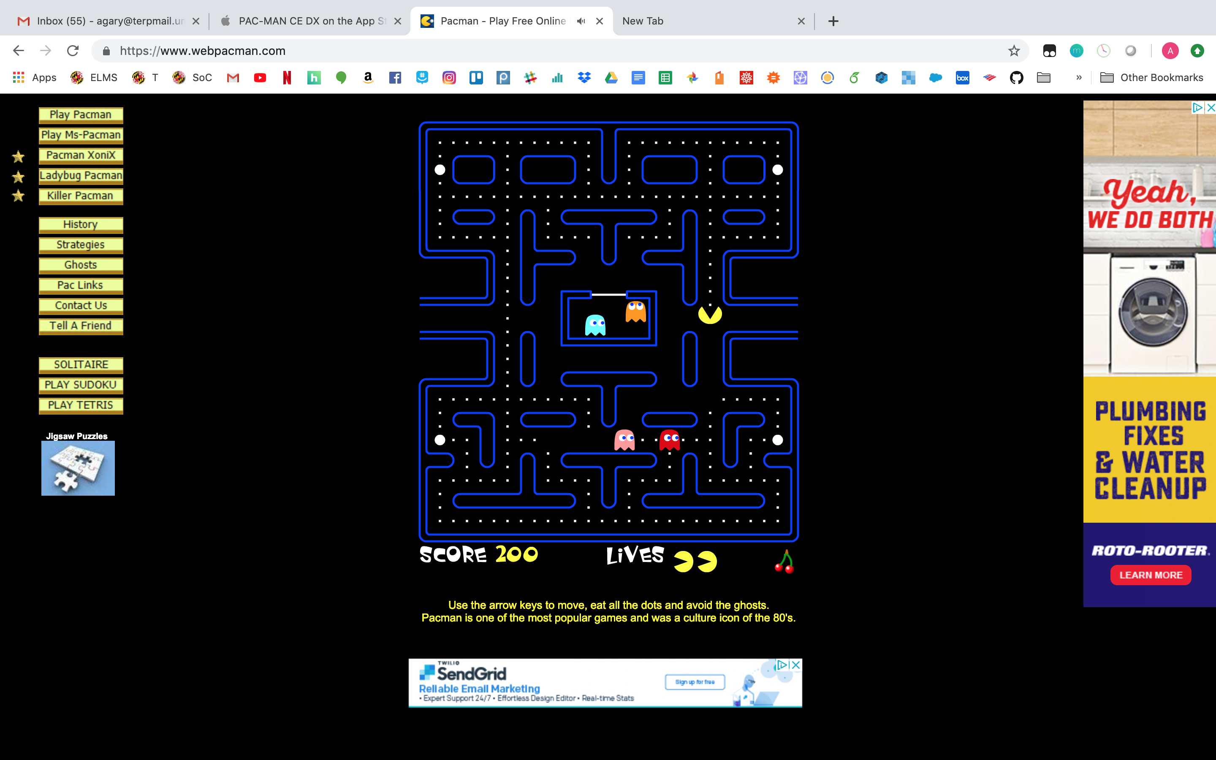
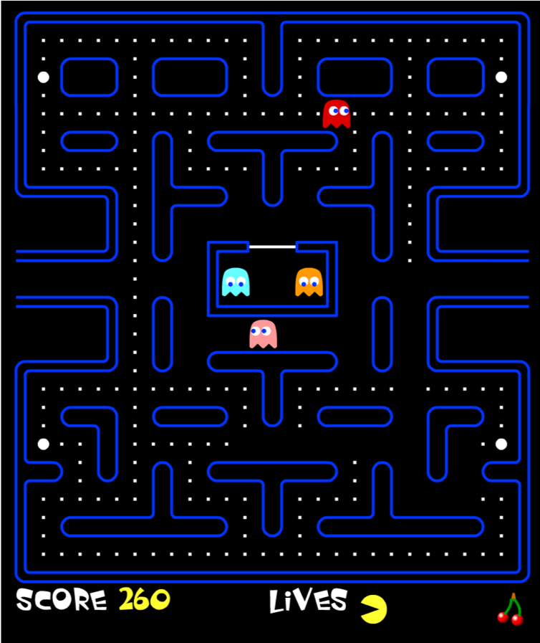
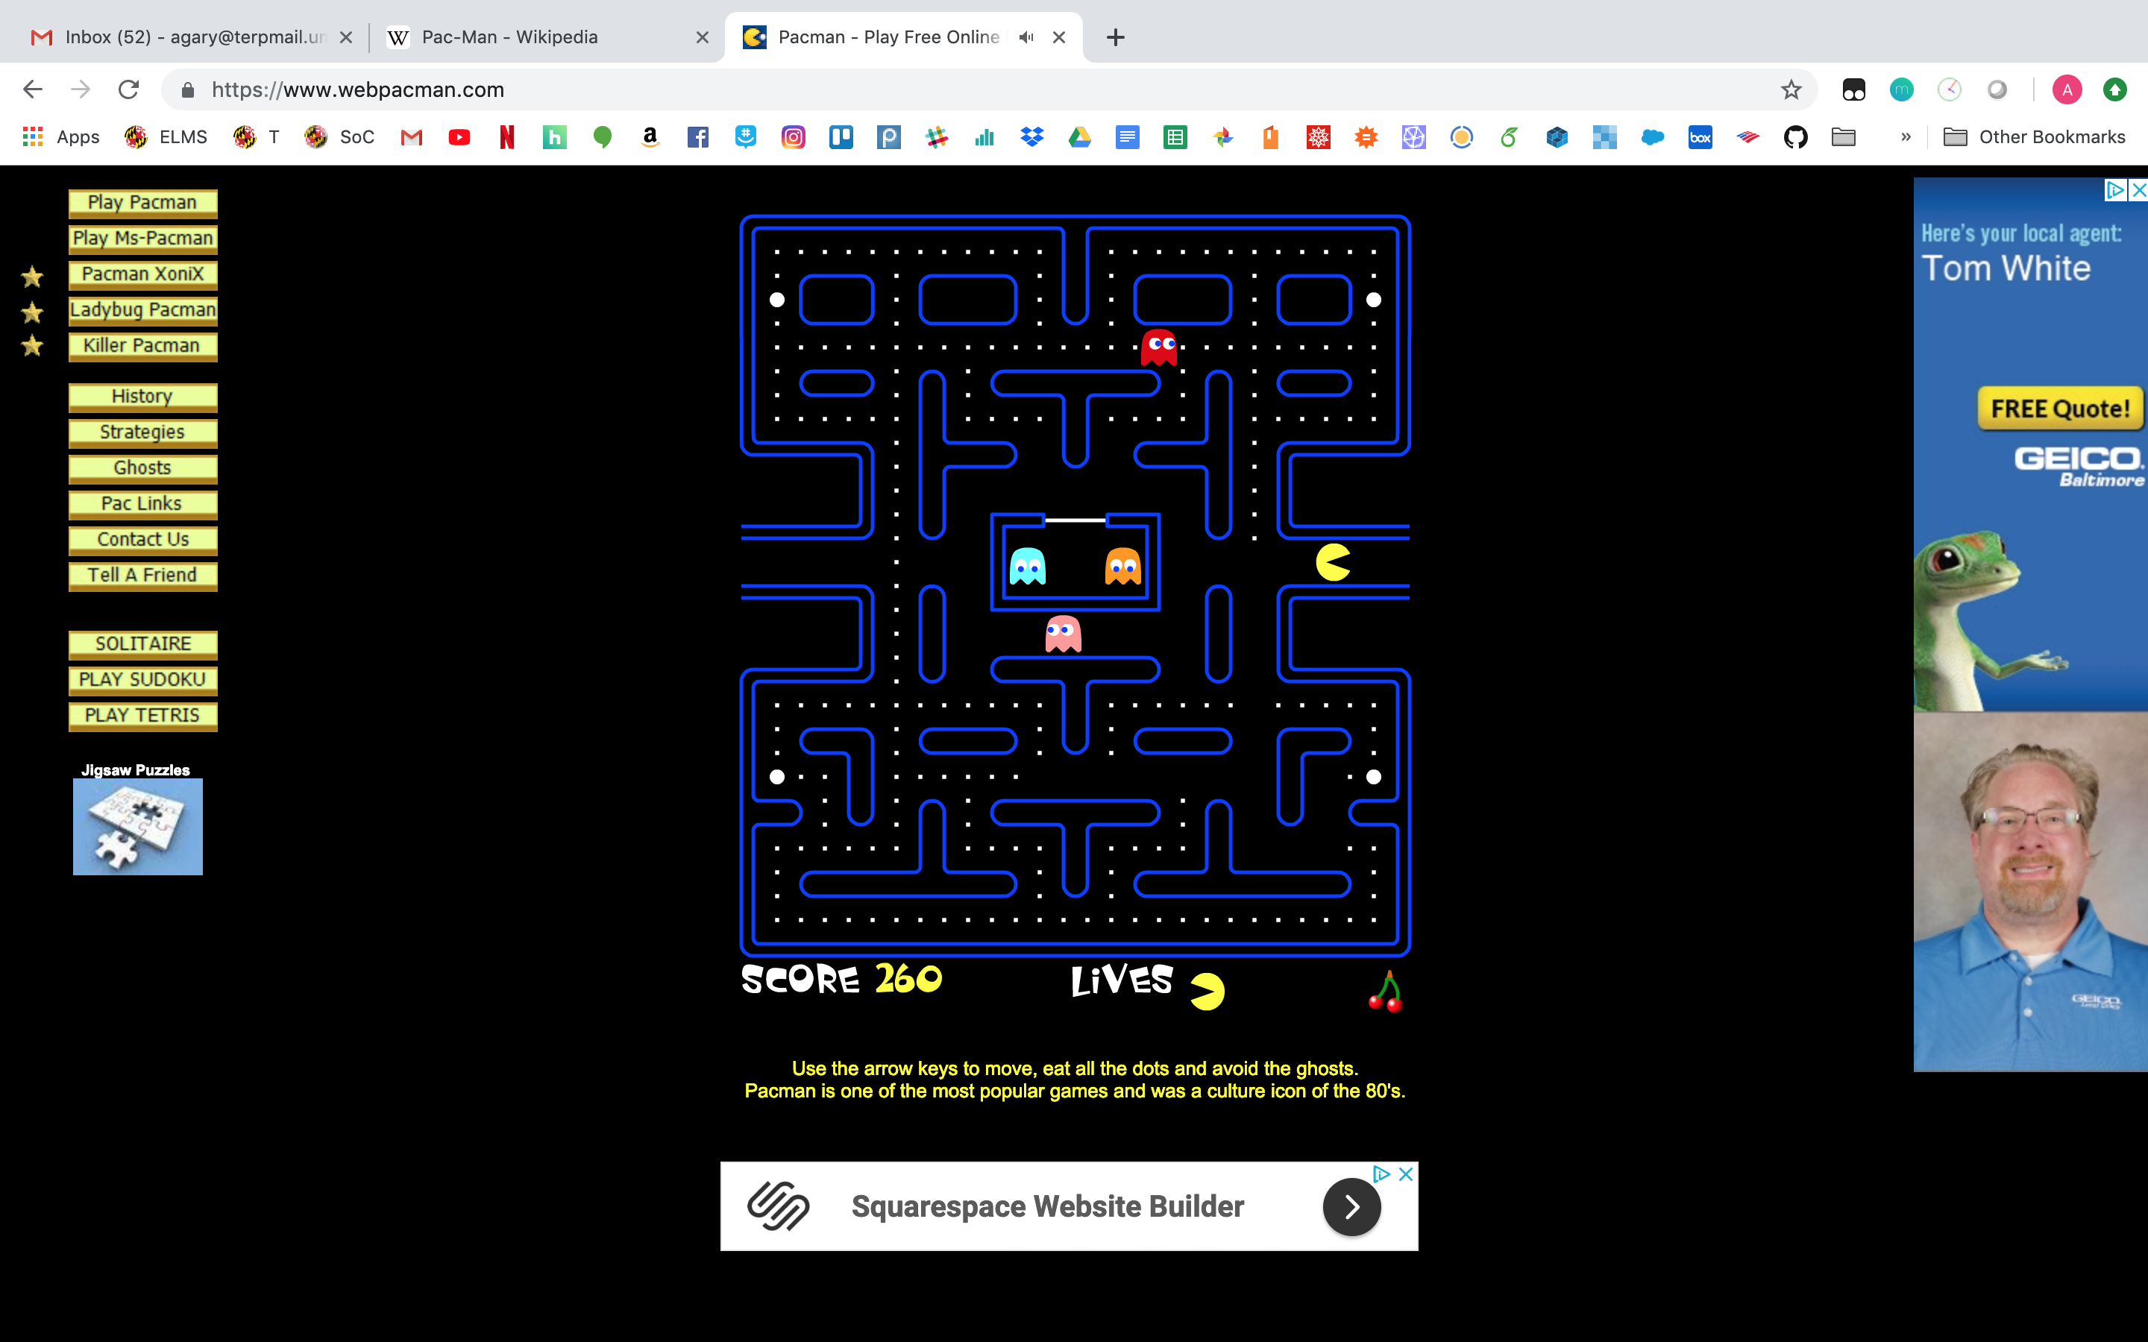
The Classic Game of Pac-Man
Pac-Man – a simple game
Eat the dots
Avoid the ghosts
You can move Up, Down, Left, Right
Can’t move through walls
How did I get here…
And…
Pac-Man can teleport across sides of the board!
That’s strange.

Slide 3

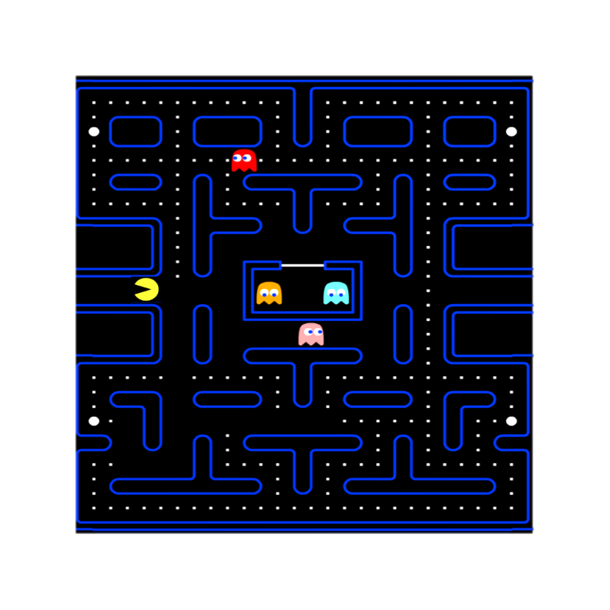
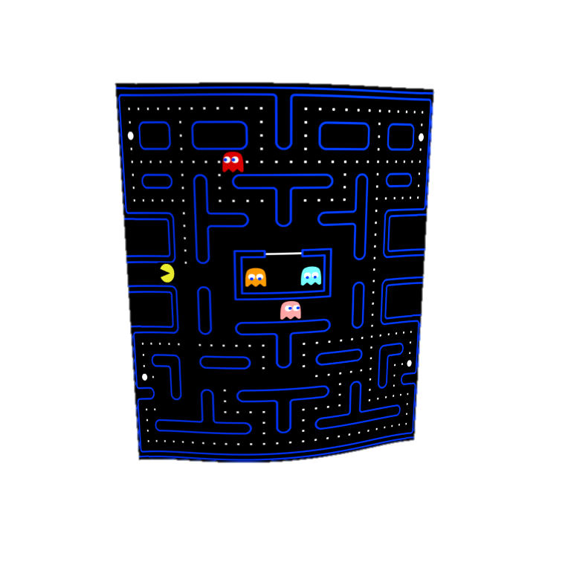
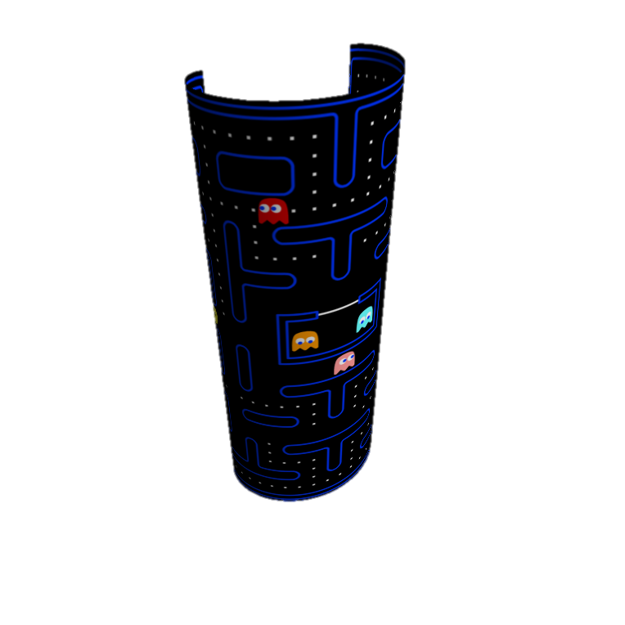
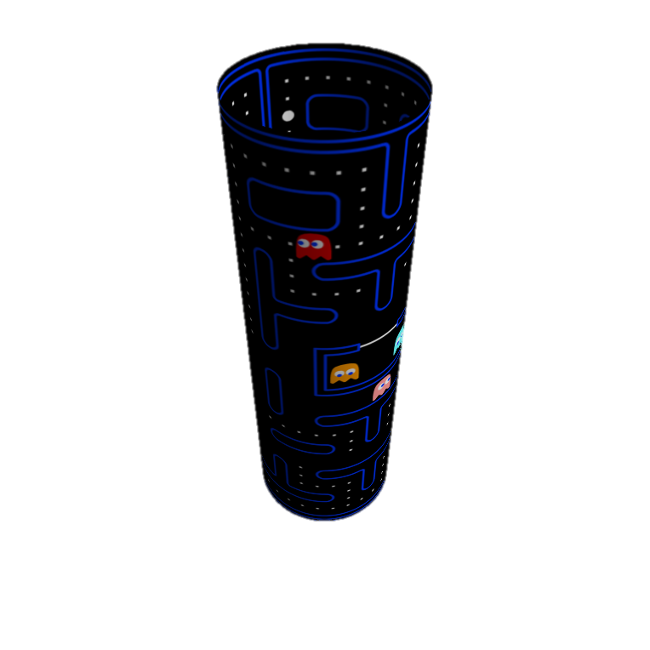
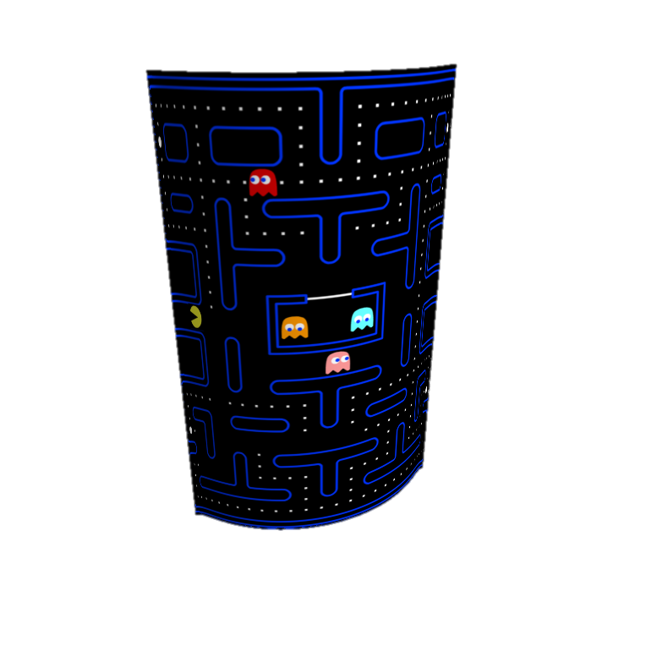
A Better Way to Play Pac-Man
Movies
Notes:
In Pac-Man’s world, the left and right sides of the screen are connected, he can pass freely from one to the other.
We can denote this with these red lines, meaning that these two sides are identified
This leads us to a better way of thinking about Pac-Man’s world than as a flat one with teleportation – if the two sides are identified anyway, why don’t we just connect them?

Slide 4
Life Through Pac-Man’s Eyes
Movies
Notes:
Now let’s see what the world looks like through Pac-Man’s eyes
To get an idea of how to think about this, let’s take a familiar example – our place on Earth
In this simulation, we’re going to pretend that we can see over the horizon, that you can see infinitely far and that, if you like, light curves around the Earth
You would see past the horizon, over the pond, and eventually all the way back around 25000 miles to see the back of your head
Then, if you like, you can keep looking farther and loop around the Earth indefinitely
This video would be what it would be like to throw a video camera into orbit and watch it fly around the Earth over and over – if you make it one continuous image, like a forwards panorama if you want, you would see something like this:

Slide 5
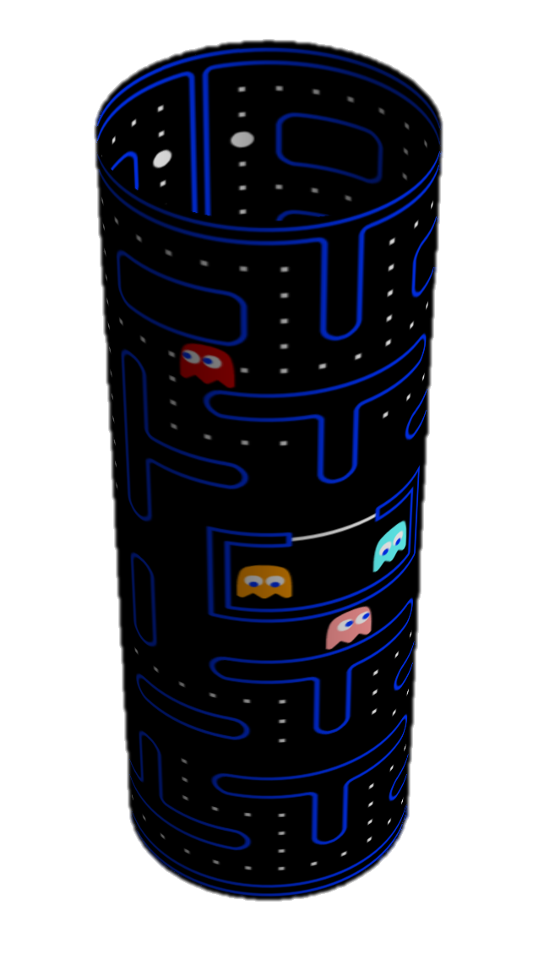
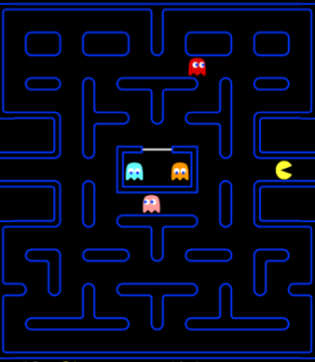
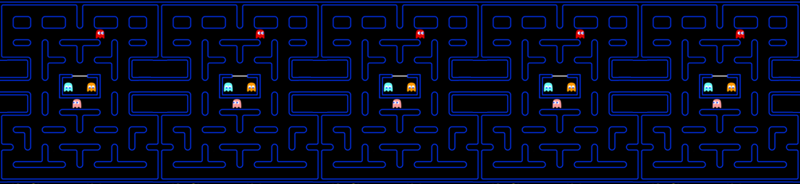
Topology Recap
Covering Space
Fundamental Polygon
Quotient Space

Slide 6
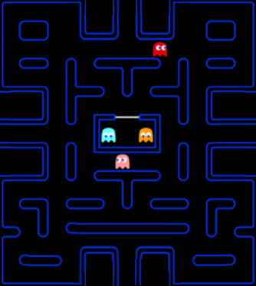
Toroidal Pac-Man – an Upgrade
Movies

Slide 7
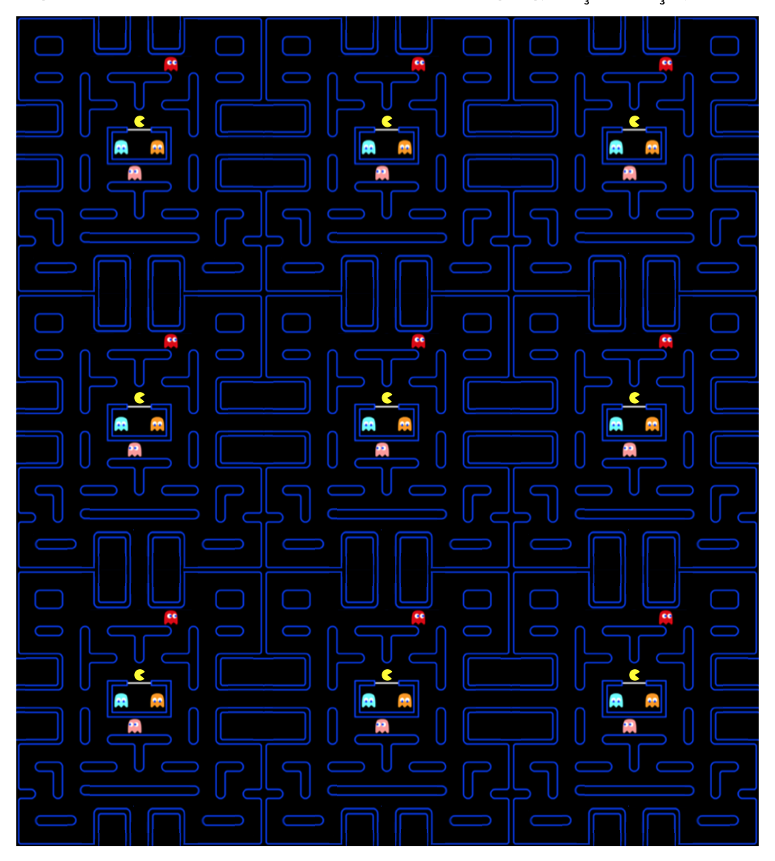
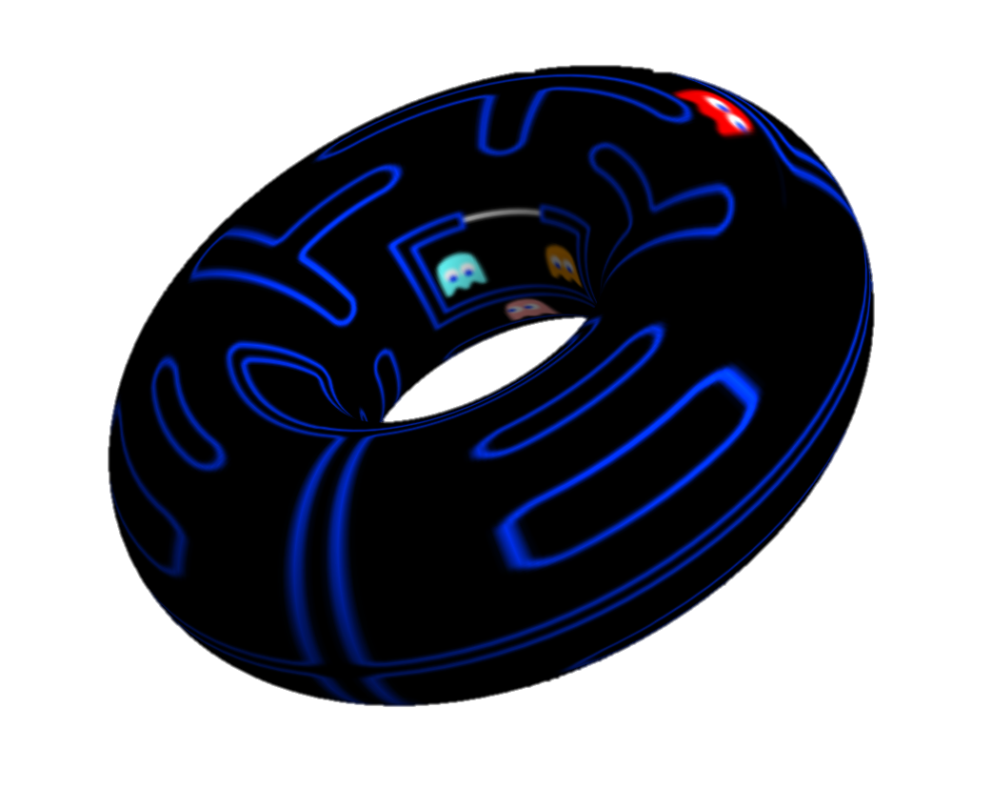
Topology of Toroidal Pac-Man
Fundamental Polygon
Quotient Space
Covering Space

Slide 8

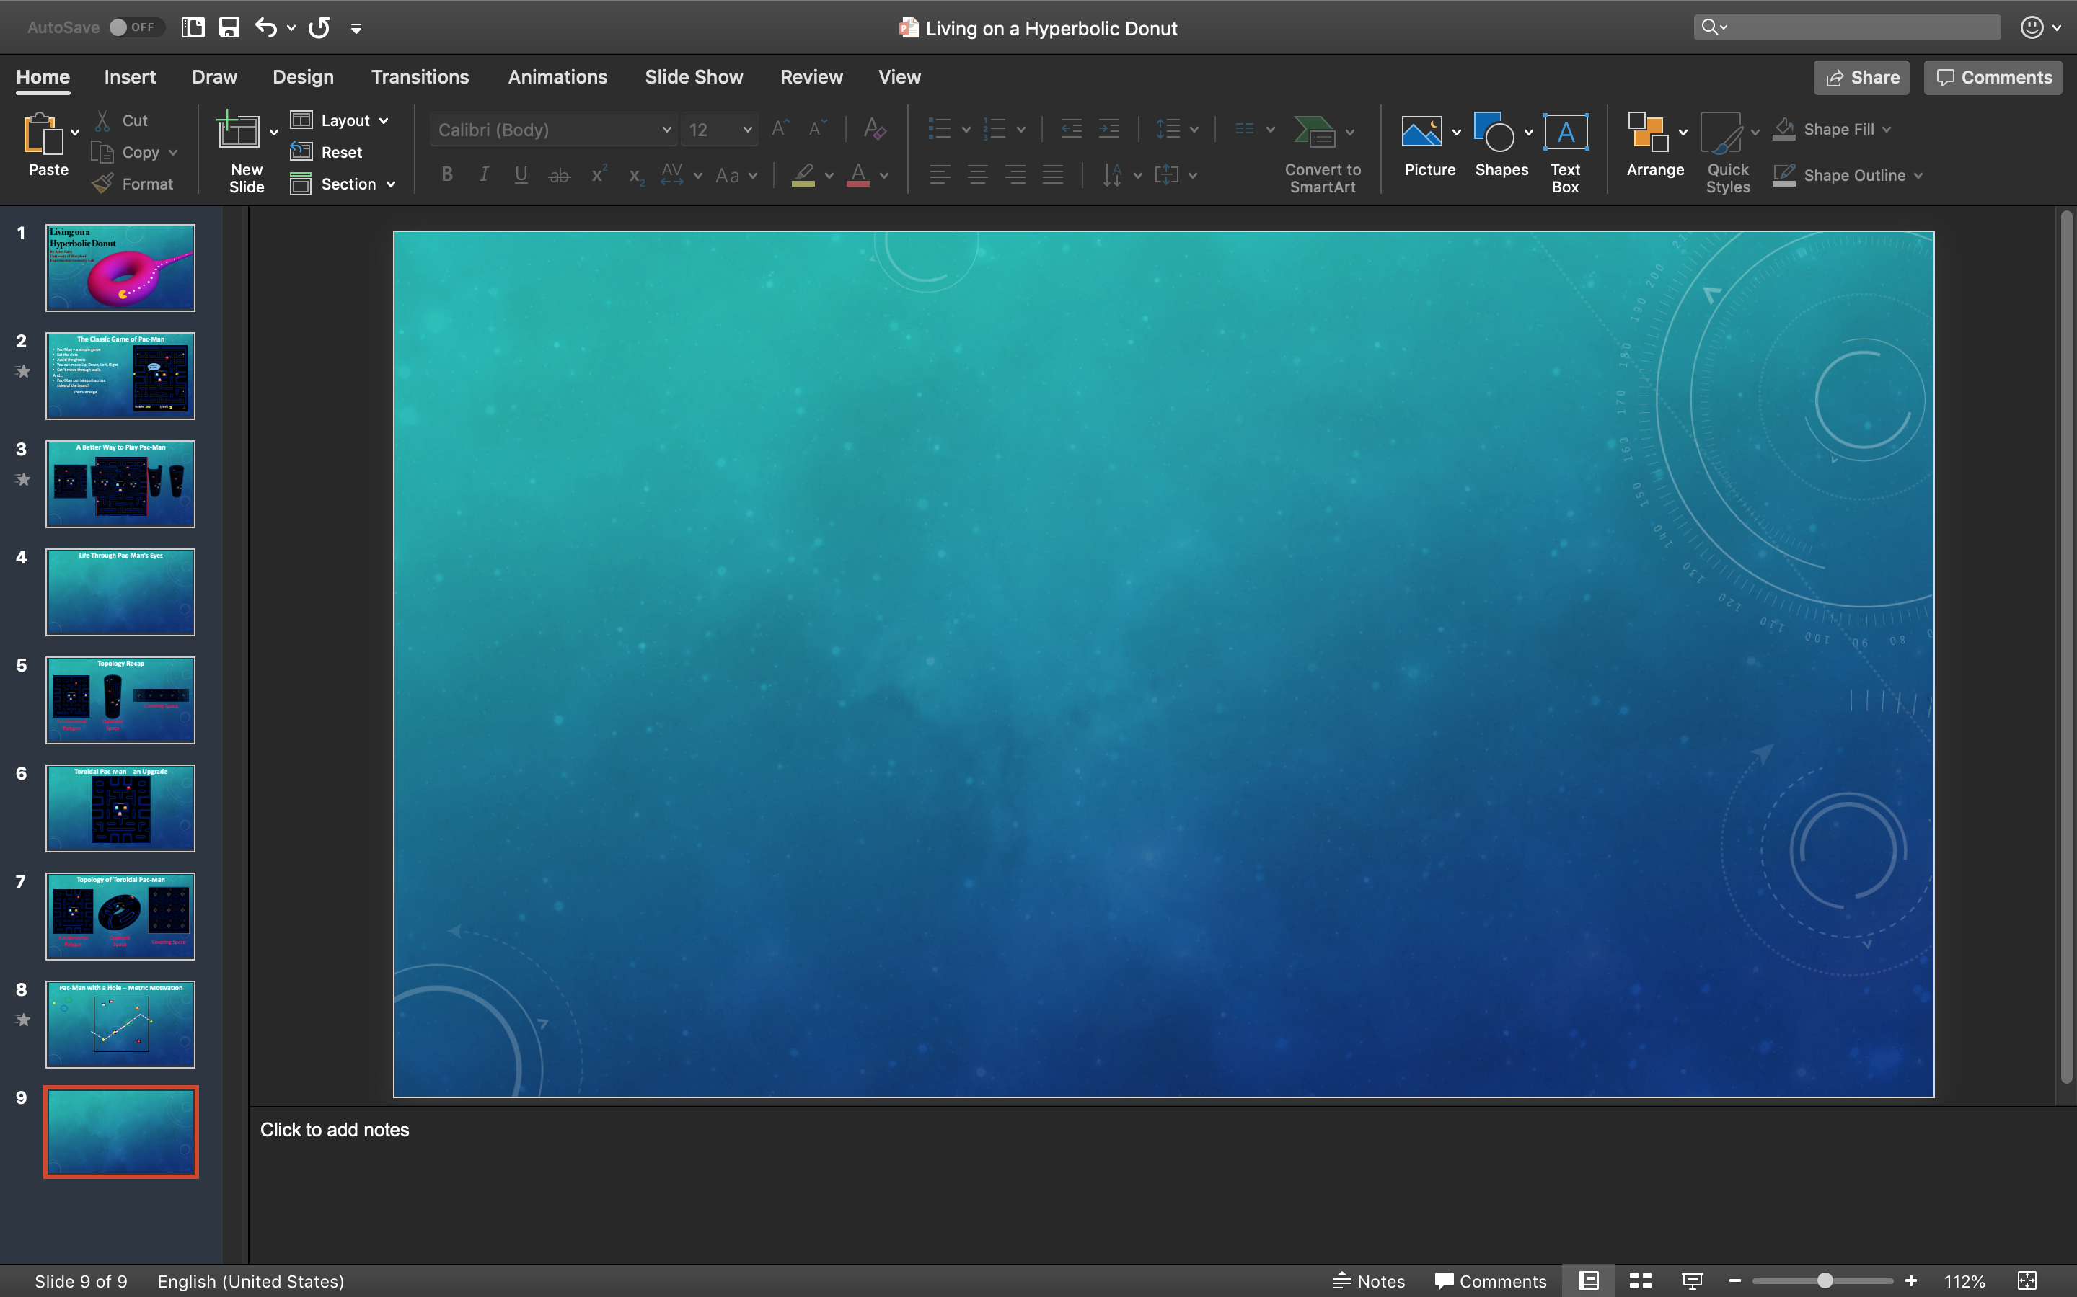

Traveling on a Torus
Notes:
Say we wanted to go from Point A to Point B – what’s the fastest way to do it?
A straight line between them of course
And we see Pac-Man travels “as the crow flies”
What if we make the start and finish farther apart?
Here is the straight line from start to finish, seems like the best we can do.
However, this is NOT the fastest way to get across the board.
The fastest way from Point A to Point B when the sides are identified, is to run off of the left side and show up on the right side.
I call this Pac-Man-ing across the boundary. If you were standing on the torus yourself, this would be obvious. We can see this on the covering space.

Slide 9
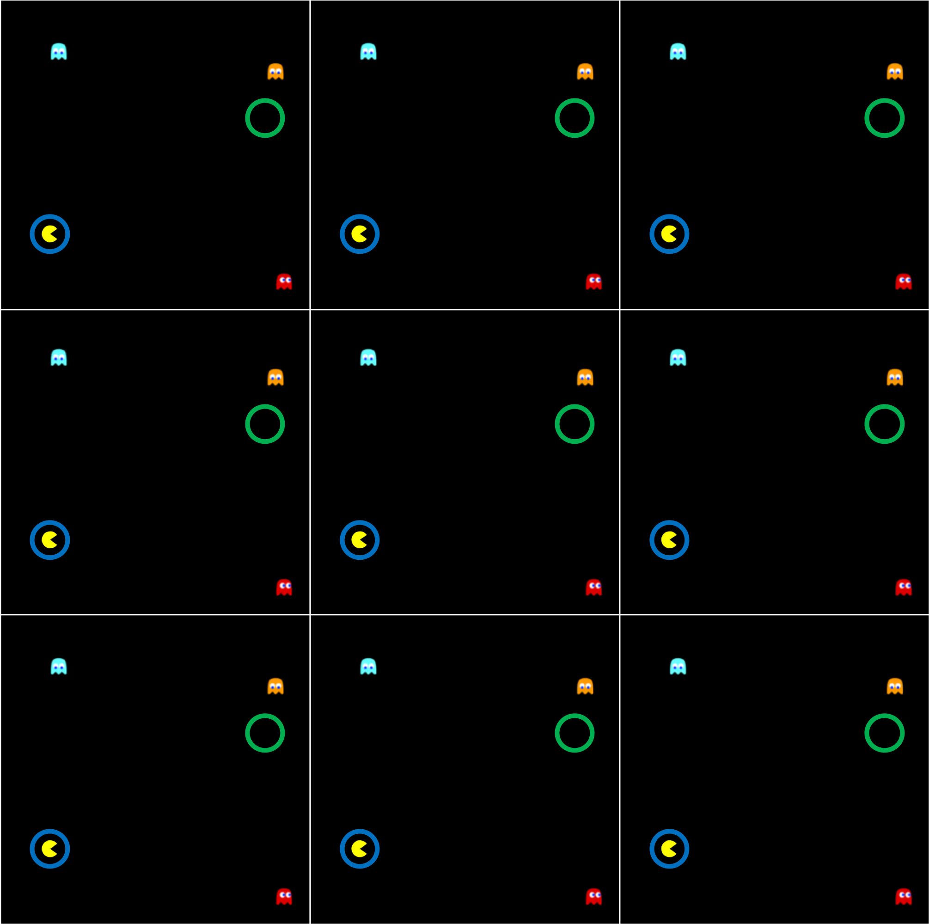
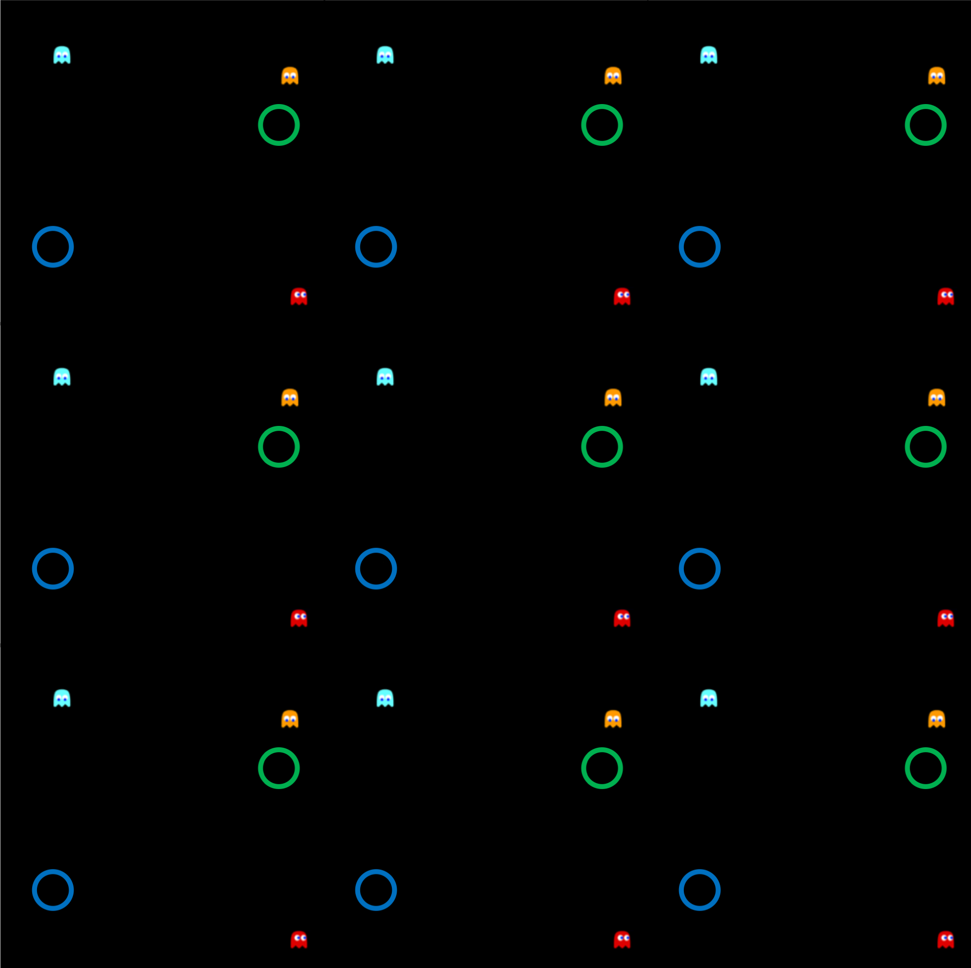
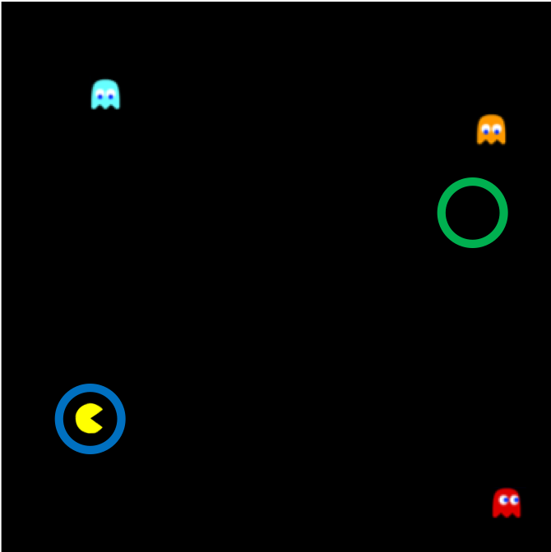
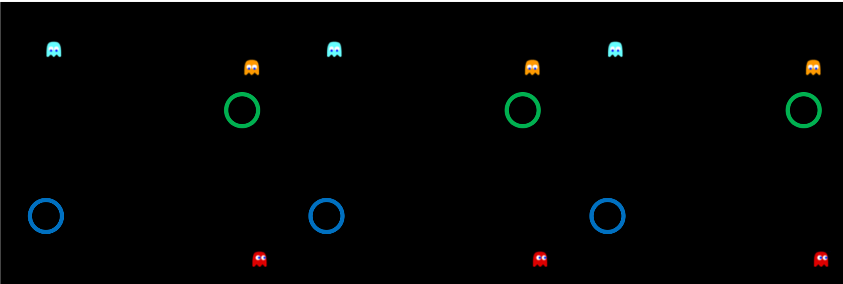
Traveling on a Torus – Covering Space

Slide 10
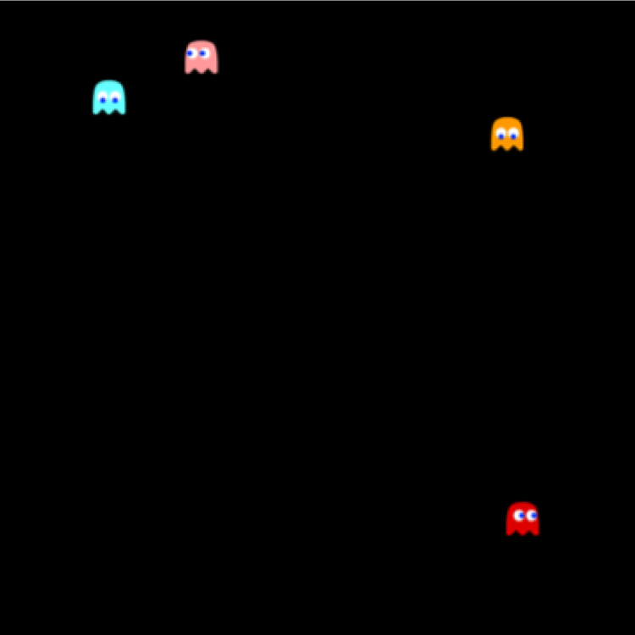

Notion: Metric
Let’s set some ground rules:
1. d is $≥$ 0
2. d(x,y) = d(y,x)
3. The Triangle Inequality
d(a,b)+d(b,c) $≥$ d(a,c)
d = 3
d = 2
d = 1
d = 1

Slide 11
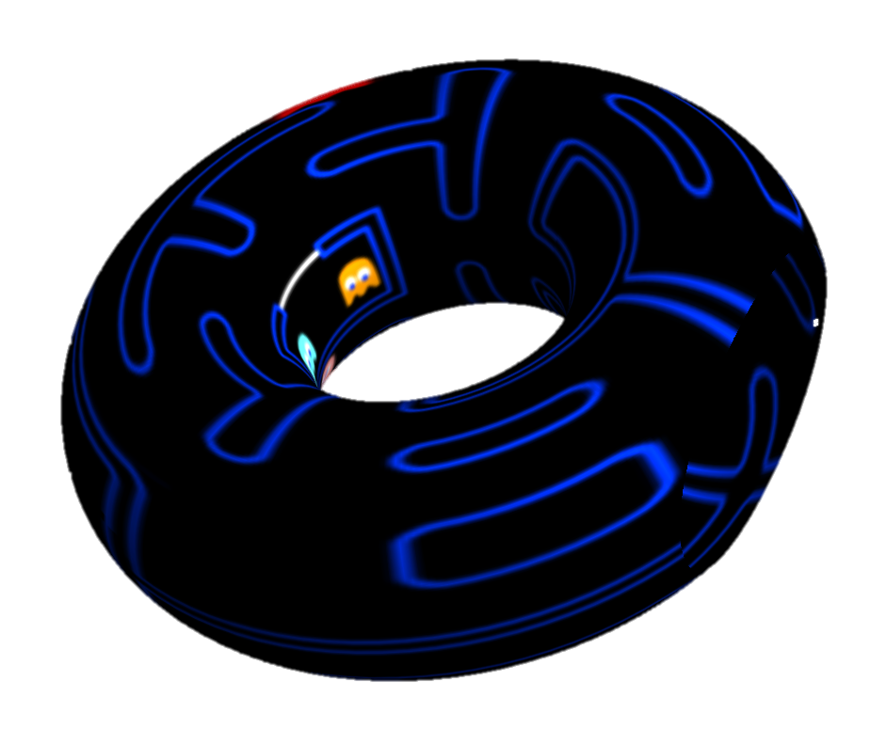

Look out, a hole!
Movies
d(green) > d(blue)

Slide 12
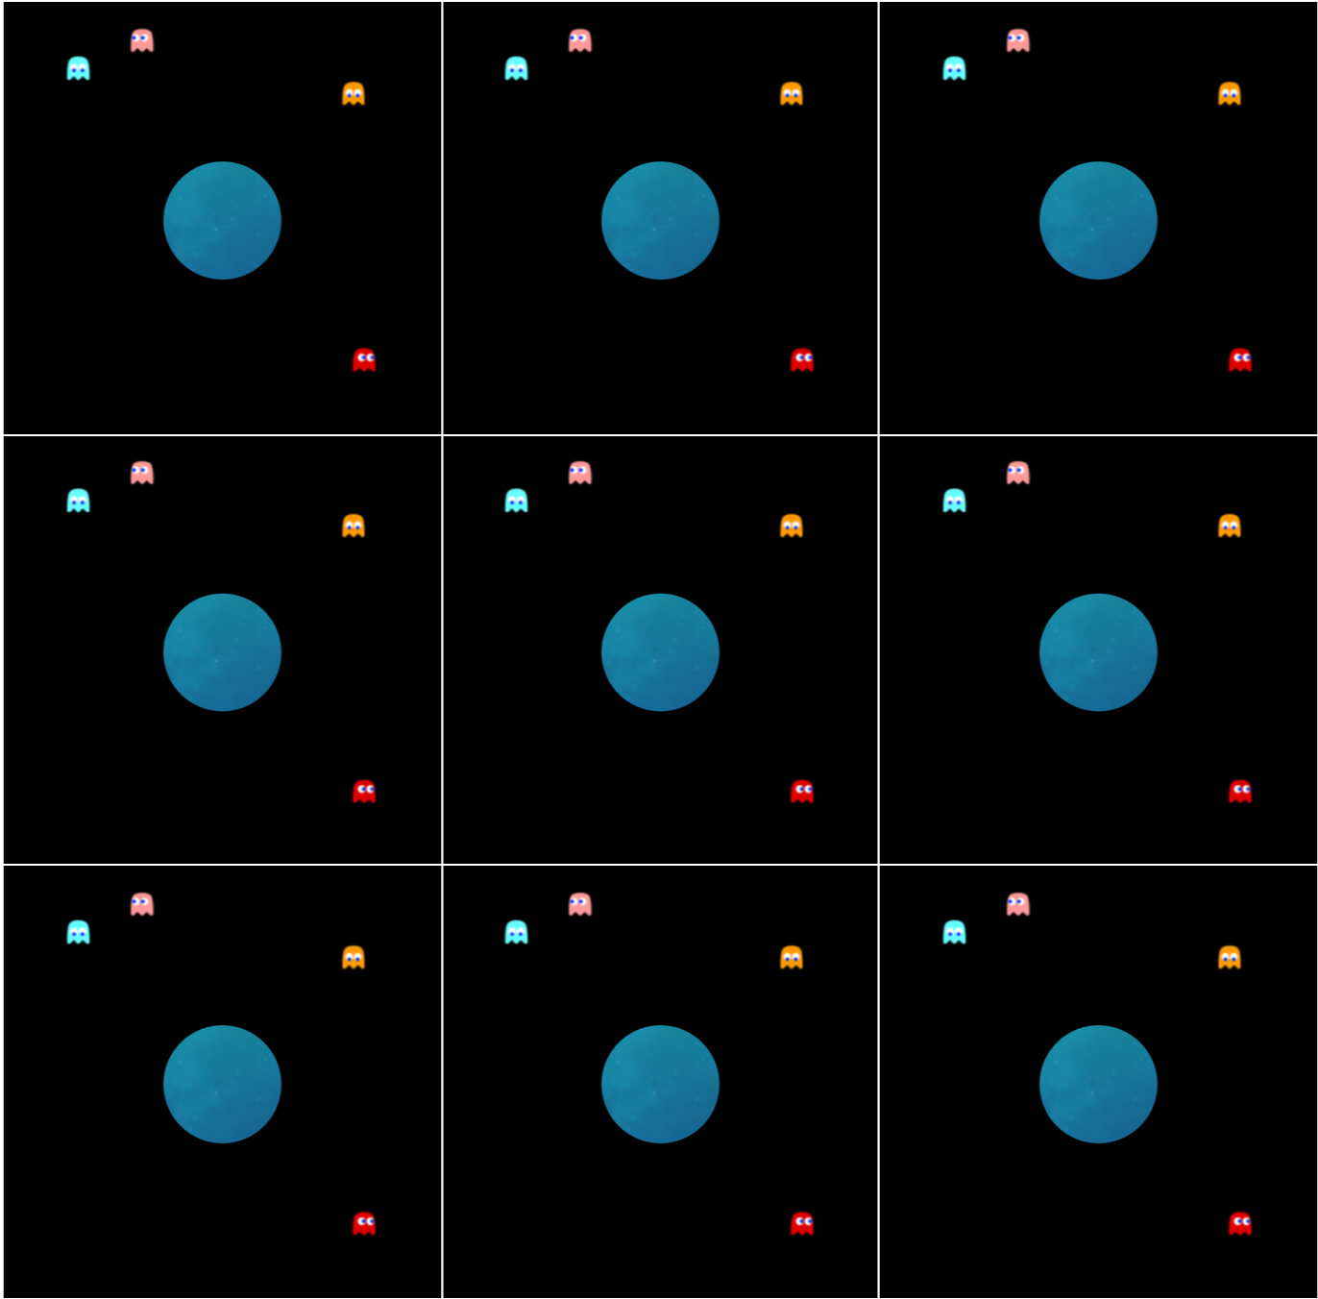
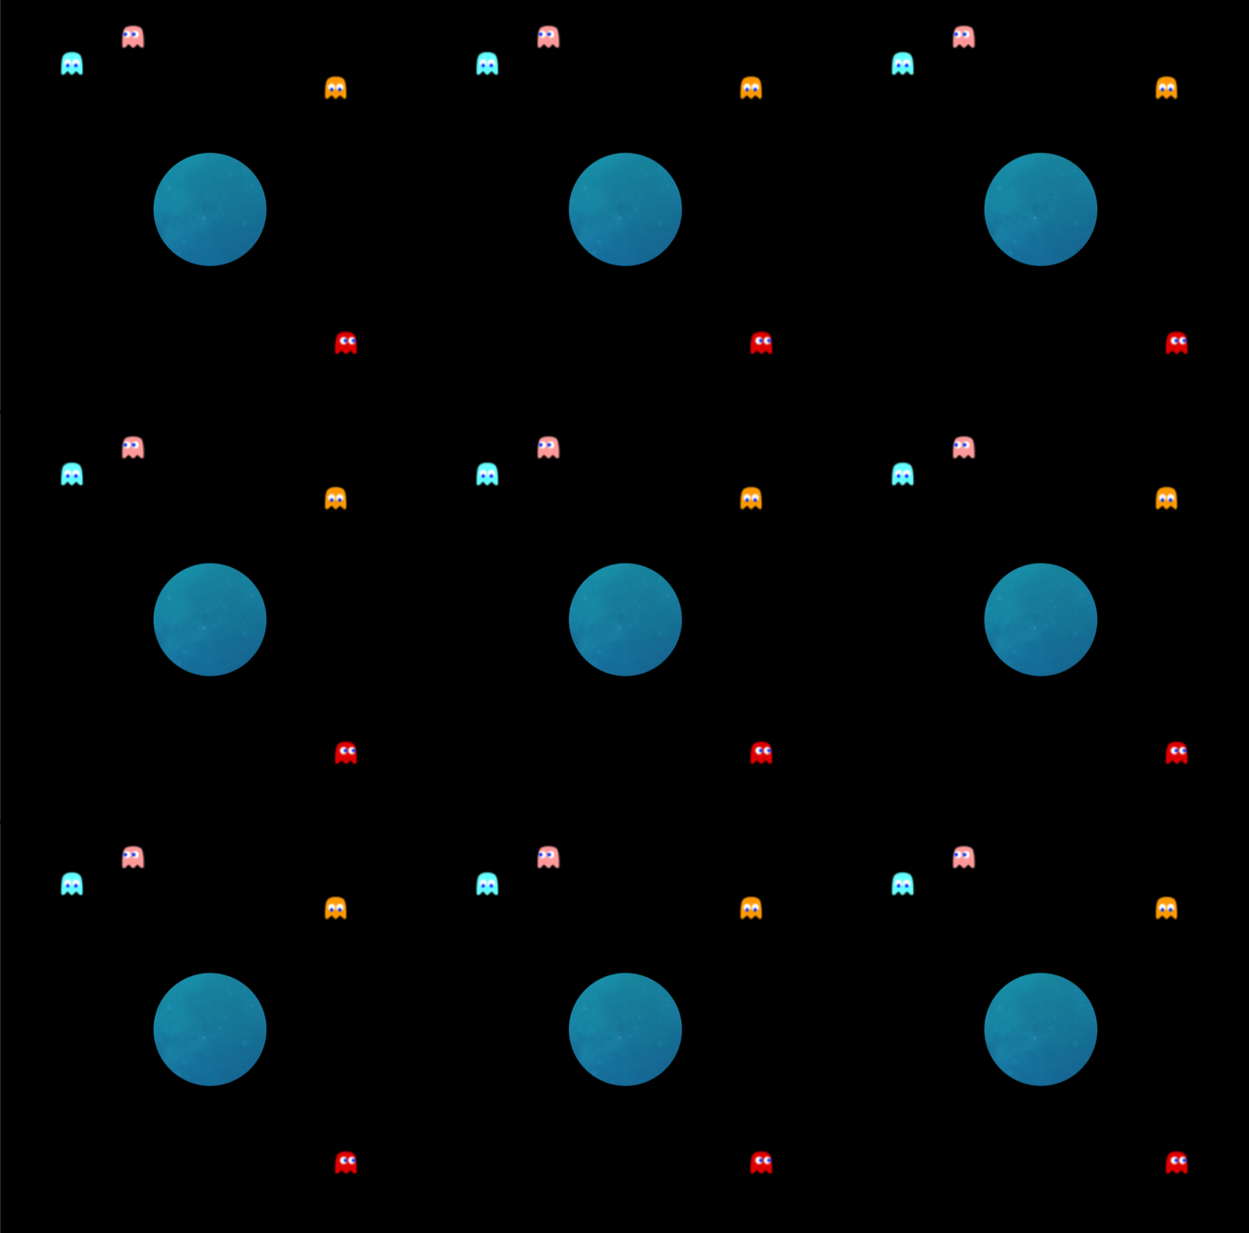
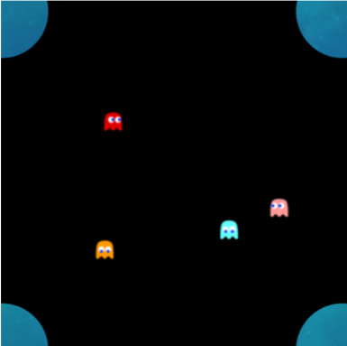
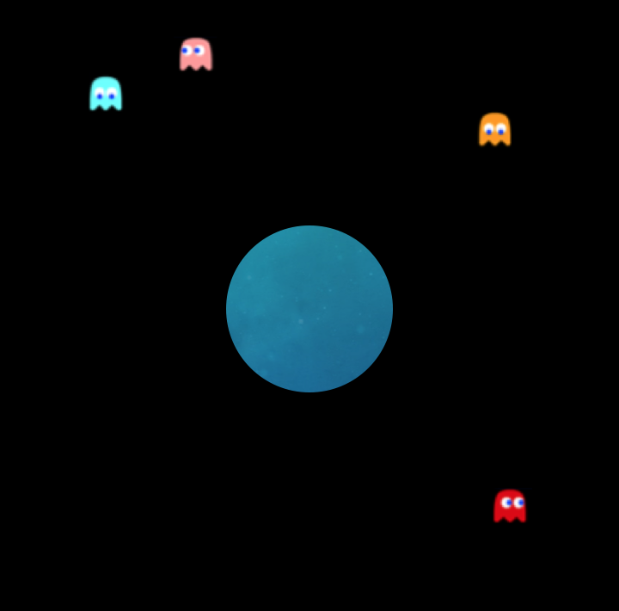
Covering Space of Holed Pac-Man

Slide 13


Something Different – Hyperbolic Geometry
$$∞$$
$$0$$

Slide 14
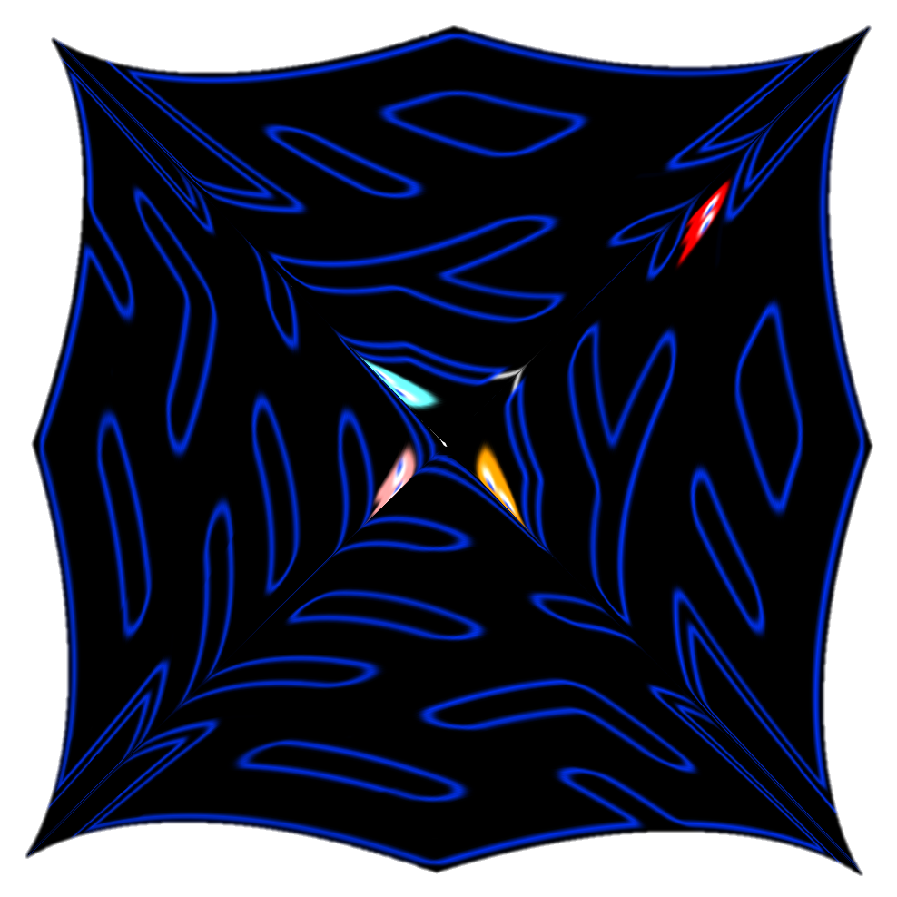
Hyperbolic Pac-Man

Slide 15
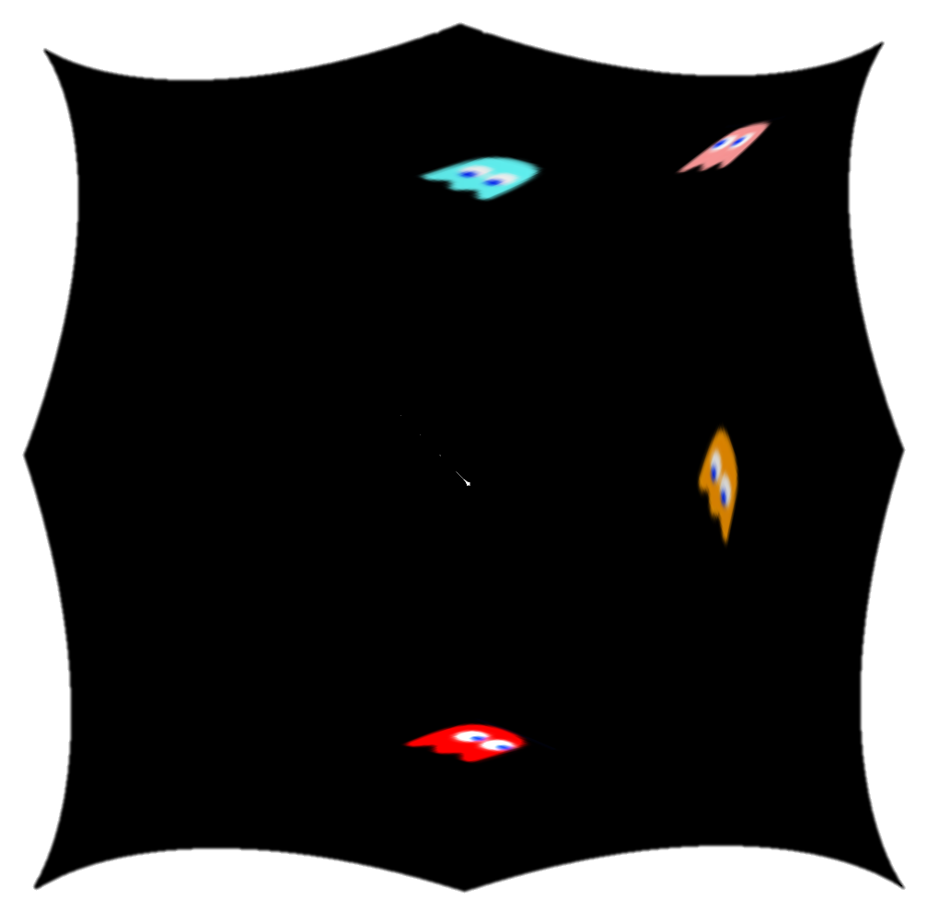

Finding the Geodesic

Slide 16
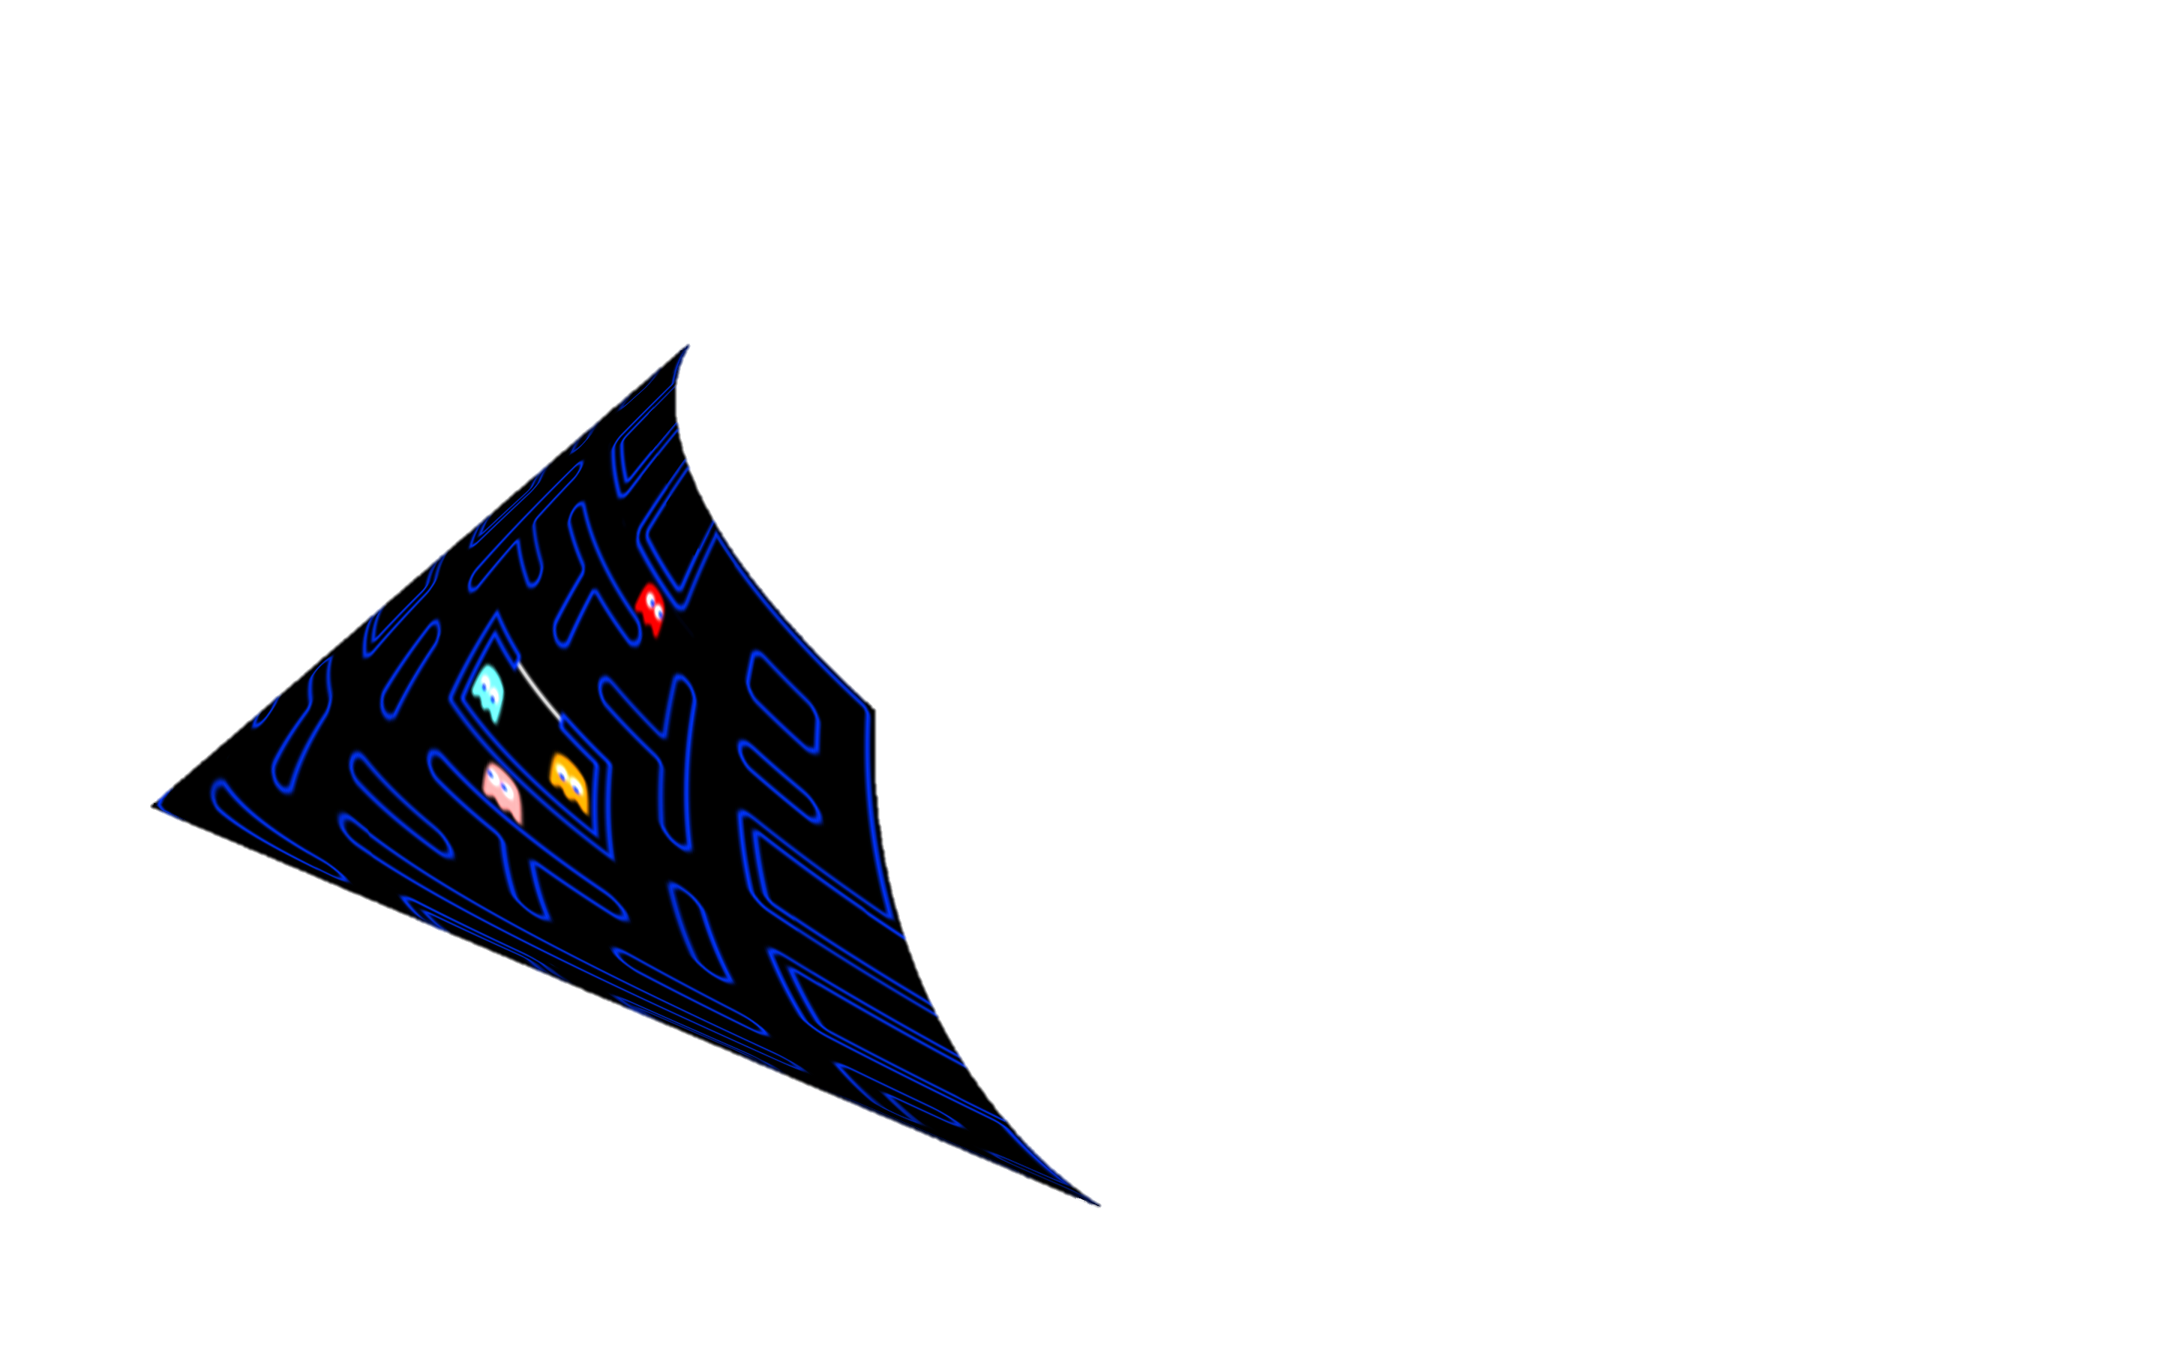
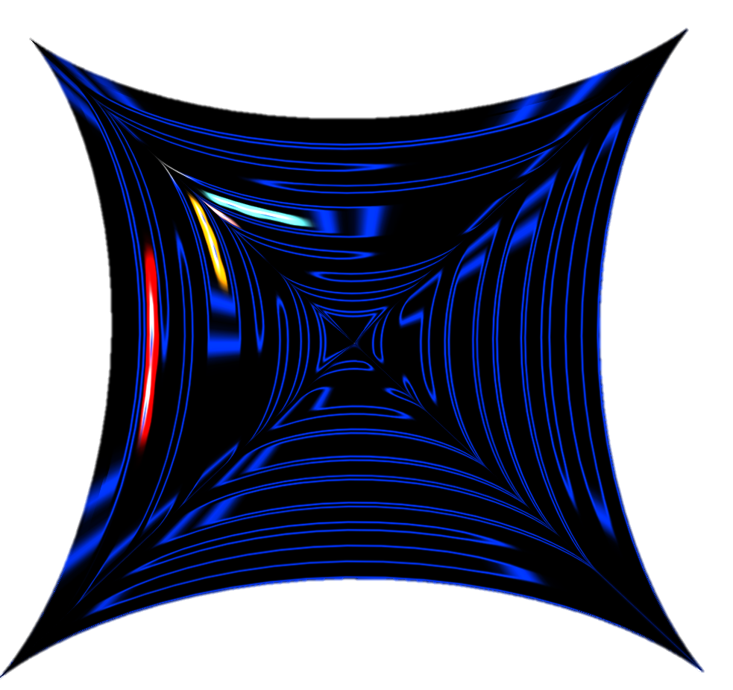
Covering Space – Tiling the Poincaré Disc

Slide 17
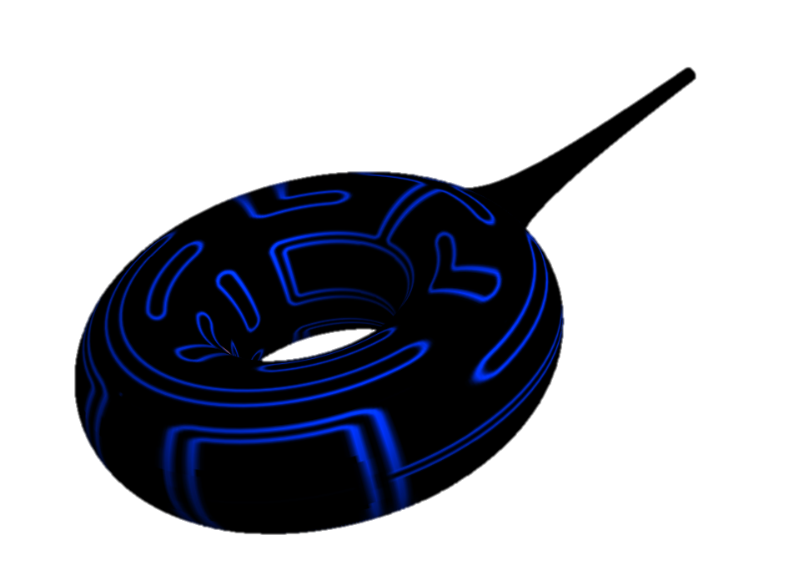
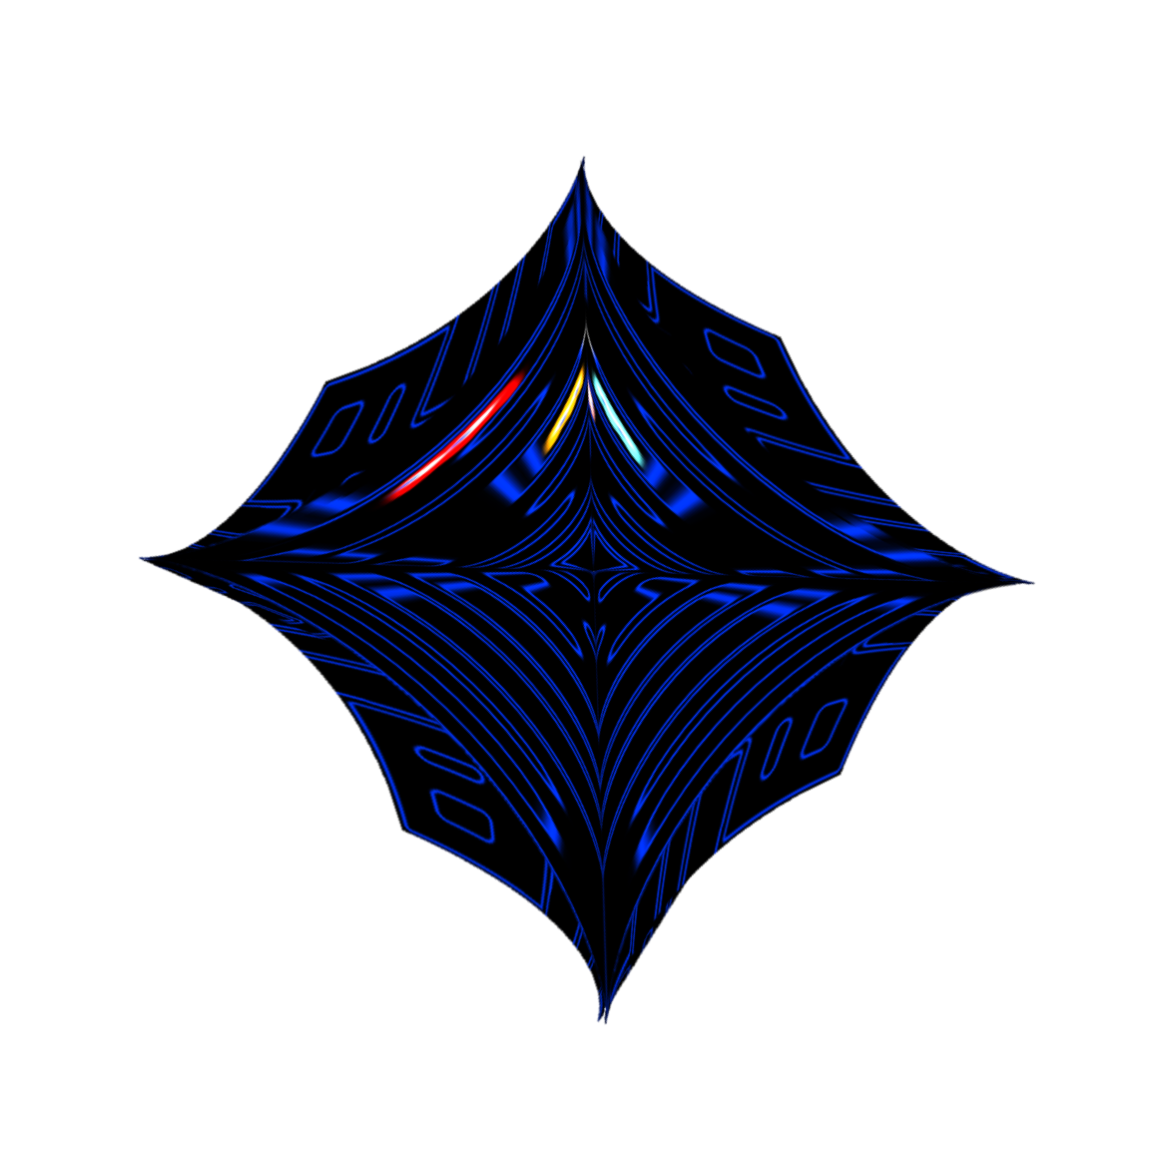

Topology Recap for the Punctured Torus
Fundamental Polygon
Quotient Space
Covering Space

Slide 18
One Last Demonstration
Movie

Slide 19

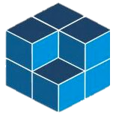

$∙ ∙ ∙$ $∙ ∙ ∙ ∙$Thank You! $∙$ $∙$ $∙$ $∙$ $∙$ $∙$ $∙$
Towson University Regional
Undergraduate Research Conference
April 6th, 2019
Ajeet Gary
University of Maryland
Experimental Geometry Lab
Research Advisor: Dr. William Goldman
REU: Summer@ICERM 2018 at Brown University
All models made in Wolfram Mathematica

